Slide 1

Mixture of Experts
CS598 FLA
Keshav Agarwal, Evan Chen, Sanjay Pokkali, Chongbin Yao, Wendi Zhao
February 7th, 2025

Slide 2

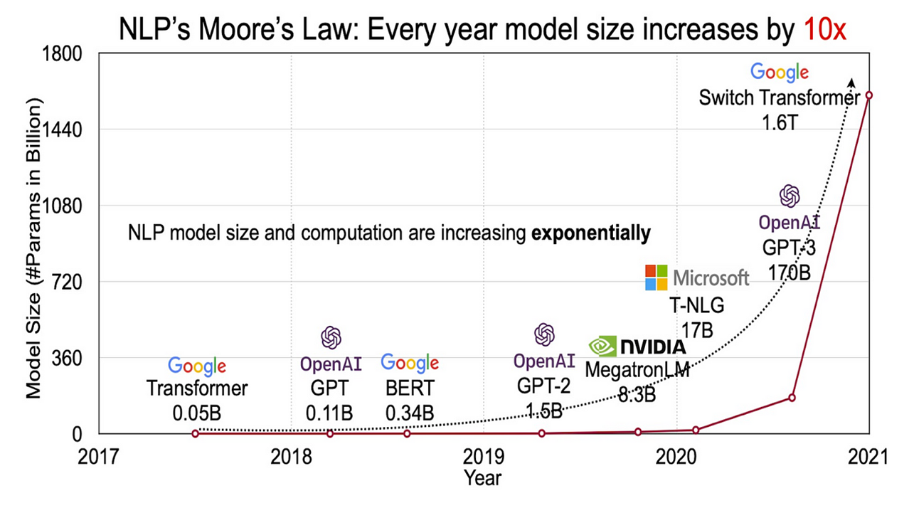
LLMs are Getting Too Large?
COMPUTER SCIENCE
GRAINGER ENGINEERING
Notes:
Charles
This is a graph showing how NLP models are evolving over years. We see that the model size is increasing dramatically, 10 times every year

Slide 3
Motivations for Mixture-of-Experts (MoE)
Dense Models Don’t Scale
From prior lectures, we’ve learned that LLMs and transformer architecture is dense.
Older models activate all parameters for every input, leading to inefficiencies in scaling.
This began pushing the limits of computational power (to train and deploy).
The Solution?
Conditional computation using a Mixture-of-Experts (MoE) layer.
Using a gated network, sparsely activate different experts depending on input
Train faster, maintain quality, and leverage specialists
COMPUTER SCIENCE
GRAINGER ENGINEERING
Notes:
Charles
So, the key challenge we're facing is that these dense models don't scale efficiently.
In our previous discussions of LLMs and transformer architectures, we established their dense nature. What does this mean in practice? Traditional models activate all parameters for every single input, regardless of whether those parameters are relevant. This creates significant inefficiencies when we try to scale these models.
This inefficient scaling started pushing against our computational limits, both for training these models and deploying them in production environments.
So what's the solution? This is where Mixture-of-Experts, or MoE, comes in. It introduces conditional computation using specialized expert layers. Instead of activating everything all the time, we use a gated network that selectively activates different expert components based on the input.
The benefits are compelling: faster training times while maintaining the quality of outputs, and the ability to leverage specialized experts for different types of tasks. Each expert can focus on what it does best, making the whole system more efficient.

Slide 4
History of MoE
Introduced and Developed
Adaptive Mixture of Local Experts (Jacobs et al., 1991)
MoE serves as a neural network architecture
Learning Factored Representations in a Deep Mixture of Experts (Eigen et al., 2013)
MoE gradually becomes a layer to insert into other neural networks.
Recently Popularized and Expanded
Outrageously Large Neural Networks (Shazeer et al., 2017)
Firstly introduced the concept of “Sparsely-Gated”, which shapes the modern design of MoE
DeepSpeed-MoE (Rajbhandari et al., 2022)
Switch Transformers (Fedus et al., 2022)
Scaling Vision-Language Models with Sparse Mixture of Experts (Shen et al., 2023)
COMPUTER SCIENCE
GRAINGER ENGINEERING
Notes:
Charles
The Mixture-of-Experts architecture has evolved significantly since its inception. It began in 1991 by this paper, as a novel neural network architecture.
Then, a major advancement came in 2013 when Eigen's team developed the concept of factored representations, transforming MoE into a modular layer that could be integrated into various neural networks.
The modern era of MoE started in 2017 with Shazeer's work on outrageously large neural networks, introducing the crucial concept of sparse gating that defines today's MoE implementations.
Recent developments have accelerated rapidly. In 2022, we saw both DeepSpeed-MoE and Switch Transformers emerge, followed by Shen's work in 2023 on scaling vision-language models using sparse MoE architectures.

Slide 5

Outrageously Large Neural Networks: The Sparsely-Gated Mixture-of-Experts Layer
Shazeer et al., 2017
COMPUTER SCIENCE
GRAINGER ENGINEERING
Notes:
Introduction
We firstly introduce this paper “Outrageously Large Neural Networks” because this paper revolutionized how MoE could be applied in deep learning.

Slide 6
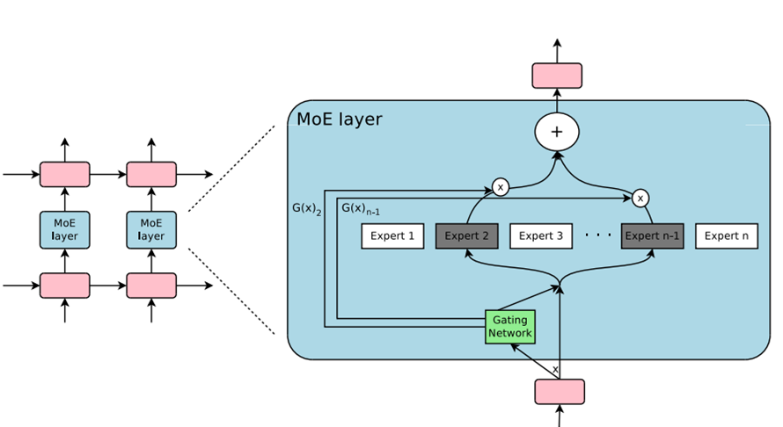
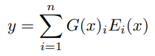
The Sparsely-Gated Mixture-of-Experts Layer
What is It?
Mixture-of-Expert (MoE) as a general-purpose neural network component
The MoE layer consists of
a set of n “expert networks" E
a “gating network" G.
Output
For a given input x,
Linearly weighted combination of each expert’s computation on the token by the gate value
COMPUTER SCIENCE
GRAINGER ENGINEERING
Notes:
Wendi
The key contribution of paper that they introduce the sparsely-gated MoE layer. MoE layer is used as a general-purpose neutral network component. More specifically in this paper, this layer is applied within a stacked LSTM-based language model as shown in the figure on the right. (pink blocks: one LSTM cell, blue blocks: one MoE layer). Within each MoE layer, there are a set of n experts (each of which is a simple feed forward neural network) and a gating network. Each MoE layer process one input x at a time. (Point to the figure to walk through) For example, this input x is sent to this specific MoE layer. On receipt, the gating network will select only few experts out of n experts and route this input x to the selected experts, according to the gate value G(x).
The output of this layer is a simple linearly weighted combination of each expert’s computation on the token by the gate value

Slide 7
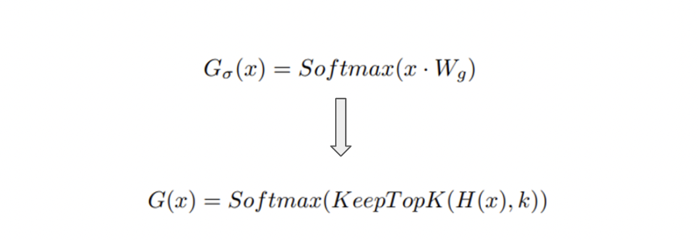
Gating Network – Noisy Top-K Gating
How does the Gating Work?
Softmax Gating: a simple non-sparse gating function
W_{g} is a trainable weight matrix
Noisy Top-K Gating:
Keep only the top k values (experts)
Set gate values of the rest to 0 to save computation
Sparsity
COMPUTER SCIENCE
GRAINGER ENGINEERING
Notes:
Wendi
So how does the gating work. A simple choice of non-sparse gating function is the softmax gating, where the input x is passed through a simple linear layer to produce the values and then the values are normalized using the softmax function. This converts the values into a probability distribution over the experts.In this paper, however, an improved gating network “Noisy Top-K Gating” was proposed, where two components are added to the standard Softmax gating: sparsity and noise. (1) For sparsity, they replaced the standard x*Wg with the function KeepTopK(H(x),K) . What it does is that instead of using all experts, only the top k experts with the highest scores (probabilities) are selected. Then, the probabilities of the rest experts were set to zero to save computation. With that, only a portion of experts are activated. (2) If we look into the H(x) component in this formula, they also add noise term to the original linear transformation. This is for load balancing across experts which we will be discussing later.
(#What is H(x) is doing: the x*Wg part is the standard linear transformation applied to the input x producing a score. The second part is to introduce noise to help with the load balancing of the experts. Linear transformation of x to compute noise sale, apply #softplus to ensure positive noise scale.
#get random noise by sampling from standard normal distribution, multiple noise by softplus-transformed scale. Add noise to gate values. )

Slide 8
Performance Challenges of MoE - Shrinking Batch Problem
Problem
If gating networks select k out of n experts for each sample, then for a batch of b examples:
Each expert process only kb/n examples - << b examples.
As number of experts increases, a MoE implementation becomes highly inefficient
Solutions
Large batch size
Mixed parallelism
Standard layers: data parallelism to optimize memory
MoE layer: model parallelism, ensuring experts are shared across devices
For a model distributed across d devices, each expert processes kbd/n examples
This is a factor of d improvements
Convolutionality
Apply the MoE layer to all time steps synchronously, increasing the input batch size by a factor equal to the number of unrolled time steps
COMPUTER SCIENCE
GRAINGER ENGINEERING
Notes:
Wendi
One performance challenge of MoE is the shrinking batch problem. In an MoE layer, only k out of n expert are selected per input. This leads to inefficiencies when training in batches. Suppose we have a batch of b examples, each gating network routes every input to k experts. So each MoE layer will be responsible for processing b x k examples. If evenly distributed to each expert, each expert will only process kb/n examples, (k=2, n=128) . As we know, GPUs are optimized for large batch sizes because they parallelize computation efficiently. Small batch size leads to poor utilization of GPU resources
daragim
The solution is to make the original batch size as large as possible. However, large batch sizes will be limited by memory. The authors proposed a mixed parallelism training paradigm where both data parallelism and model parallelism are used to train the model. For standard layers, conventional data parallelism is employed to optimize the memory, and different batches will run synchronously so that they can be combined for the MoE layer. For MoE layers, model parallelism is used meaning experts are distributed across device. Each expert is only stored in one device, but all devices can send tokens to all experts. So this will result in a factor of d improvements.
Another solution suggested by the authors is that, instead of applying the same MoE to each time step of the previous layer. If we wait for the previous layer to finish, we can apply the MoE to all the time steps together as one big batch. Doing so increases the size of the input batch to the MoE layer by a factor of the number of unrolled time steps.

Slide 9
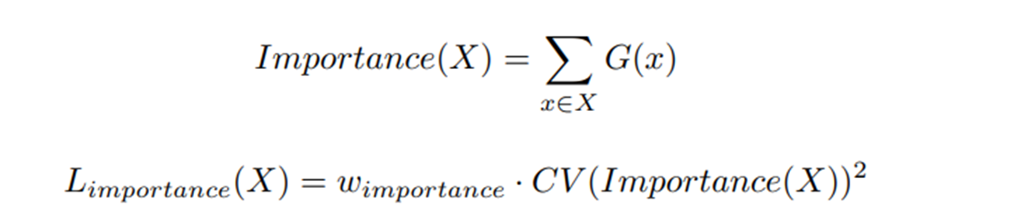
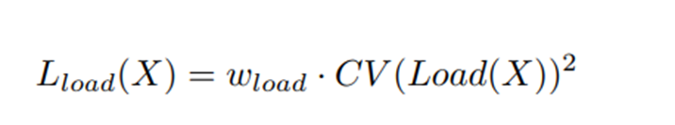
Balancing Expert Utilization - Soft Constraint Approach
Balance across experts
Gating network tends to always select the same experts.
Importance loss
Experts may receive very different numbers of examples
Load-balancing loss
COMPUTER SCIENCE
GRAINGER ENGINEERING
Notes:
Wendi
The other issue pertains to the MoE is the balancing problem across the experts. Gating network tends to always select the same experts and each experts may receive very different number of examples. To address this, the authors used the soft constraint approach by introducing additional losses.
To address the first issue that gating network tends to select the same experts, an importance loss is added to the main loss. We first determine the importance of each expert, by summing G(x) (probability) assigned by the gating network for all input x. This measures how often each expert is selected across a batch. If only a few experts get large I value, it mean the gating network is biased toward them, which is not what we want/ What they do is that they penalize the variance in expert importance so that experts are used more equally. If experts are used equally, the variance is low -> No penalty, if some experts are used to much, variance is high -> large penalty. WIth that they encourage gating to distribute workload more evenly.
Even though more experts are selected, some experts may still receive too many inputs, while others receive too few, this causes load imbalance . An additional loss load balancing loss is introduced. First determine the load of inputs on each experts which is Load(X)i. The load is calculated by summing the probabilities of expert i should be selected for inputs. I wouldn’t dive into the details on how we calculate the P(x,i). I just want to highlight the noise term that we mentioned in the Noisy Top-K Gating network. So, once we get the Load for each expert, we penalize the large variation of loads across experts.
***side note
(probability P(x, i) => probability that expert i should be selected for input x )
(The (x*Wg) is the gating value and kth_excluding is the gating values of the k-th chosen expert excluding expert i (avoid bias)
(The numerator measures how much higher/lower expert i is compared to the threshold for the top-k experts
The denominator is learned noise factor that smooths the selection probabilities (to make it differentiable)
The CDF is to ensure it is probabilistic
The load for each expert of all i => then compute the coefficient of variation which measures how much the load varies across experts (squaring amplifies the imbalances)

Slide 10
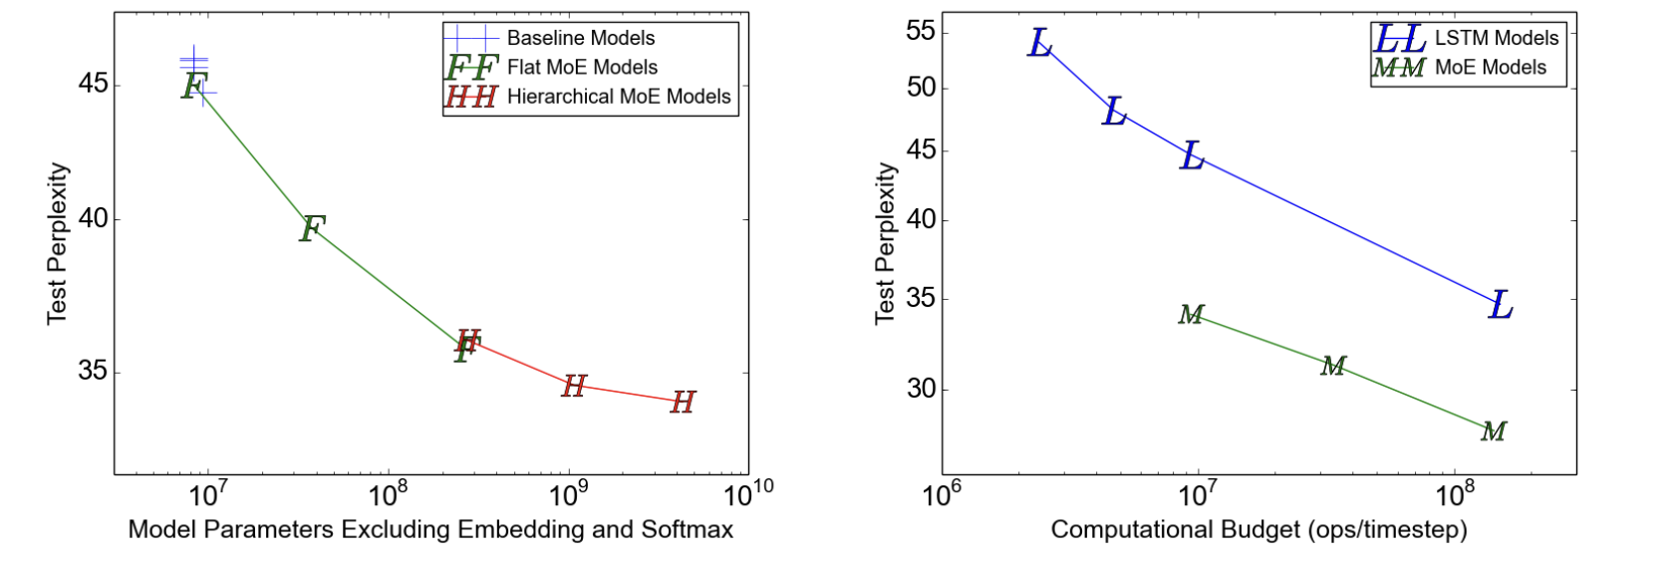
Sparsely-Gated MoE Experiments (1)
Dataset: 1 BILLION WORD LANGUAGE MODELING BENCHMARK
Two stacked LSTMs with an MoE layer between them.
Flat and hierarchical MoE tested with varying number of experts
Each expert has 1 million parameters
In each MoE layer, 4 experts were active per input
COMPUTER SCIENCE
GRAINGER ENGINEERING
Notes:
Sanjay
The dataset consists of shuffled unique sentences from news articles, totaling approximately 829 million words, with a vocabulary of 793,471 words.
Left Graph: (Testing Perplexity)
Perplexity: How well a model can predict the next word in a sequence of text (lower is better)
The flat MoE model will always have 4 experts active since there is only one layer. Its performance is similar to that of the baseline.
Hierarchical MoE models performed significantly better (lower test perplexity is better)
Right Graph: (Testing Computation)
MoE gives Better perplexity for similar computational budget (I think they use hierarchical MoE)

Slide 11
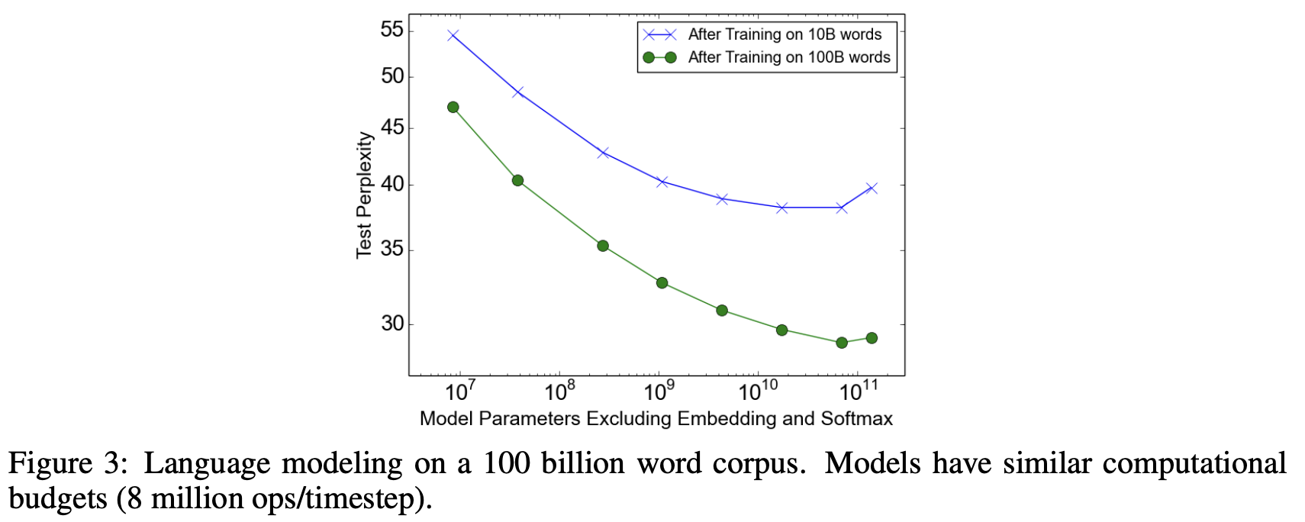
Sparsely-Gated MoE Experiments (2)
Dataset: 100 BILLION WORD GOOGLE NEWS CORPUS
Figure 3 shows test perplexity as a function of capacity after training on 10 billion words (top line) and 100 billion words (bottom line)
Test perplexity improves till a certain number of experts then degrades. May be due to too much sparsity
COMPUTER SCIENCE
GRAINGER ENGINEERING
Notes:
Sanjay
On the 1-billion-word corpus, adding additional capacity seems to produce diminishing returns as the number of parameters in the MoE layer exceeds 1 billion
The authors hypothesize that for a larger training set, even higher capacities would produce significant quality improvements

Slide 12
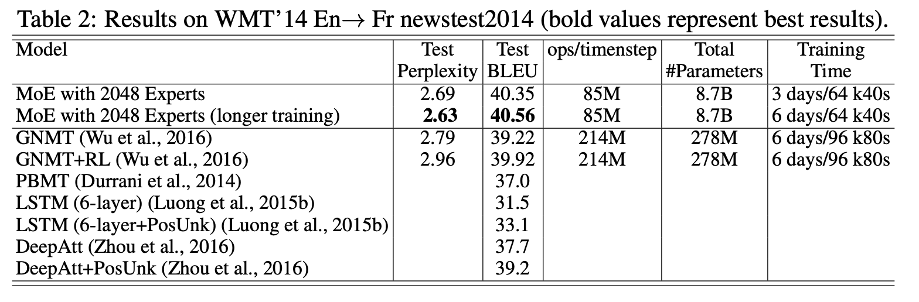
Sparsely-Gated MoE Experiments (3)
MACHINE TRANSLATION (SINGLE LANGUAGE PAIR)
Modified version of GMNT Model with reduced number of LSTM layers in the encoder and decoder
They inserted MoE layers in both the encoder (between layers 2 and 3) and the decoder (between layers 1 and 2)
Each MoE layer consisted of 2048 experts with around 2 million parameters each
COMPUTER SCIENCE
GRAINGER ENGINEERING
Notes:
Sanjay
This experiment was on language translation. There were two datasets, English to French and English to German

Slide 13
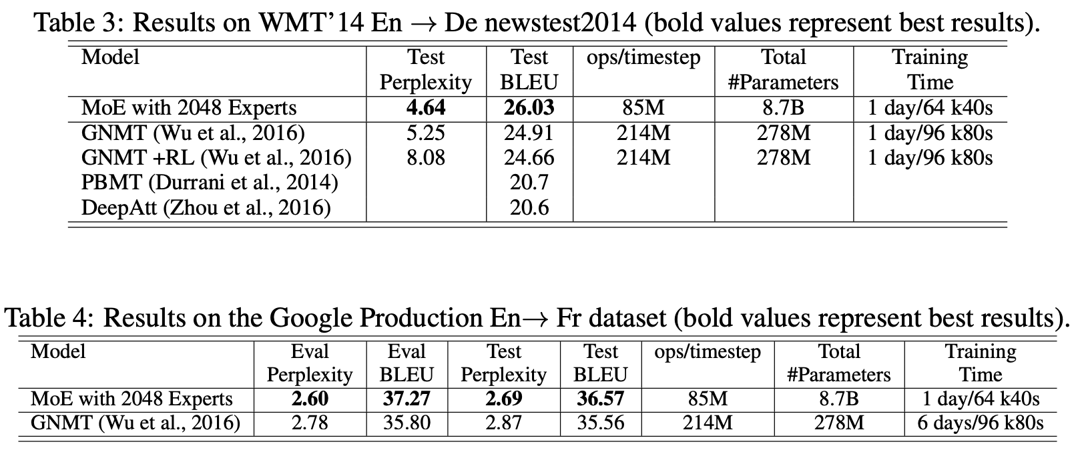
Sparsely-Gated MoE Experiments (3, Cont.)
MACHINE TRANSLATION (SINGLE LANGUAGE PAIR)
COMPUTER SCIENCE
GRAINGER ENGINEERING
Notes:
Sanjay

Slide 14
Drawbacks of MoE
Limited Scope
Scope of MoE primarily in NLP because of the use of encoders and decoders
Limited exploration in other domains and applications
Massive Memory Requirement
MoE’s require significantly more total parameters than their dense counterparts
MoEs generally are less parameter efficient compared to equally dense networks
Model size and parameter inefficiency leads to memory challenges in training and interference
Limited Inference
Fast inference using MoEs is challenging because of the large model size and poor parameter efficiency
Large parameter models usually require >1 GPU and Multi-GPU interference not designed for MoE
Inference is usually memory bandwidth bounded so MoEs have much higher memory bandwidth requirement
COMPUTER SCIENCE
GRAINGER ENGINEERING
Notes:
Sanjay
We have talked about all the benefits MoE’s bring. But No rose is without its thorns. Lets talk about MoE’s thorns now!
There are three main

Slide 15
Solutions / Improvements?
Our second required reading lists a few!
COMPUTER SCIENCE
GRAINGER ENGINEERING
Notes:
Sanjay
What are some potential improvements? Can anyone think of any? (open to audience)
Next Evan and Keshav will discuss improvements upon Naive MoE!

Slide 16
DeepSpeed-MoE: Advancing Mixture-of-Experts Inference and Training to Power Next-Generation AI Scale
Rajbhandari et al., 2022 (Microsoft)
COMPUTER SCIENCE
GRAINGER ENGINEERING
Notes:
Evan and Keshav will split the slides for this paper!

Slide 17
How to solve those challenges?
DeepSpeed-MoE Solutions
Expanded Scope
Applied MoE to autoregressive NLG tasks
Achieved 5x training cost reduction for GPT-3/MT-NLG scale models
Enables higher model quality within current hardware limitations
Improved Parameter Efficiency
Introduced PR-MoE (Pyramid-Residual MoE): Reduces model size by 3x with no quality loss
Developed MoS (Mixture-of-Students): Further reduces size by 3.7x through distillation
Maintains model quality while significantly reducing parameter count
Optimized Inference System
Scales efficiently across hundreds of GPUs
7.3x faster and cheaper than existing MoE inference solutions
Enables sub-25ms latency for trillion-parameter models
Up to 4.5x faster and 9x cheaper than equivalent dense models
COMPUTER SCIENCE
GRAINGER ENGINEERING
Notes:
Evan
So, how can we address some of the challenges that were discovered by the ONN paper? Well, Microsofts’ DeepSpeed MoE finds a few solutions that we will discuss in this presentation. First, we can expand the scope of MoE to autoreg natural language tasks. By doing this, we reduce the training cost for GPT3 scale models and achieve higher model quality.
Second, we can improve the parameter efficiency. We will go into more technical detail about the two strategies mentioned by the paper, PR-MoE, and MoS, that reduces model size and parameter count while maintaining quality.
Third, we can optimize model inference by scaling across many GPUs in parallel, enabling magnitudes faster and cheaper inference times for even the largest models (trillions of params).

Slide 18
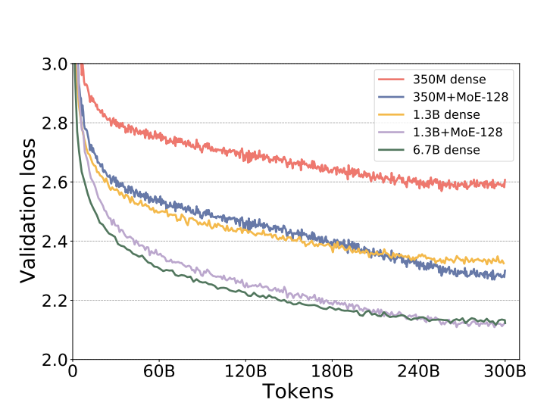
Transforming NLG Model Training with MoE
The Challenge
Natural language generation models (like GPT-3) are crucial for tasks ranging from document summarization to code generation, but their training requires enormous compute resources. This creates a significant barrier to advancing model quality.
The Innovation
DeepSpeed-MoE applies Mixture-of-Experts to NLG models in a novel way:
Uses a base model with 128 experts on alternating layers
Employs top-1 expert selection per token, maintaining compute efficiency
Activates only base model parameters per token (e.g., 1.3B parameters for 1.3B+MoE-128)
Figure showing token-wise validation loss curves for dense and MoE NLG models with different model sizes.
COMPUTER SCIENCE
GRAINGER ENGINEERING
Notes:
Evan
Let’s talk a bit more about transforming the natural language model training. As we all are likely familiar with, models like GPT3 are critical for menial tasks, but they require a lot of compute - the main barrier to advancing model quality. DeepSpeed-MoE applies MoE to Natural Language models in a novel way - by using the base model with 128 experts on alternating layers. We select the best expert per token to maintain efficiency from a computational perspective. And we only active the base model parameters for each token. On the left, we can observe in the figure that our validation loss for MoE models is relatively close to the dense model alternative, showcasing that we maintain levels of performance despise the architectural difference and reduction of size.

Slide 19
5x Cost Reduction with Equal Quality
Key Findings:
Quality Equivalence
350M+MoE-128 matches 1.3B dense model performance
1.3B+MoE-128 matches 6.7B dense model performance
Validated across 6 zero-shot tasks including LAMBADA, PIQA, and BoolQ
Efficiency Gains
5x reduction in training compute requirements
Same quality as larger dense models at fraction of cost
Training throughput improved significantly on A100 GPUs
Potential Impact
This scaling suggests trillion-parameter model quality could be achieved at the cost of training a 200B parameter dense model, potentially saving millions in training costs and energy usage.
COMPUTER SCIENCE
GRAINGER ENGINEERING
Notes:
Evan
Let’s talk more about the size reduction. The MoE DeepSpeed models tested in this paper match performance of dense models magnitudes larger (350M to 1.3B, and 1.3B to 7.7B parameters respectively) – NOTE these numbers are in context of the parameters activated per token. The validation was done across a variety of zero-shot tasks including [read slide].
Overall, it is about a 5x reduction in computational requirements during training, which is a fraction of the cost attributed to A100 GPU training.
Now, imagine the implication of this speed up - of course, more work would need to be done to verify the truth of this claim, but to put 5x into perspective, imagine if a trillion parameter model might only be the cost of a 200 billion dense model, which would save millions in cost and energy.

Slide 20
Making MoE Models More Efficient
The Problem with More Parameters
While MoE models reduce training costs by 5x, they come with a significant drawback:
“parameter bloat”
8x more parameters than equivalent dense models
Example: 1.3B+MoE-128 uses 52B total parameters vs 6.7B in dense model
Creates two critical challenges:
High memory requirements during training
Memory bandwidth bottleneck during inference
But how did the authors tackle this? PR-MoE + MoS.
COMPUTER SCIENCE
GRAINGER ENGINEERING
Notes:
Evan
Despite the huge improvements in training cost, there is one challenge - the parameter bloat. DeepSpeed MoE models struggled with memory requirements and bottlenecks during both training and inference because they use more total parameters, enabling less per token but requiring more across the board.
As an example, the 1.3B MoE model stores 52B params compared to 6.7B in the equiv dense model.
So, to tackle this, the authors leveraged PR-MoE and MoS, which we will now explain in the next few slides.

Slide 21
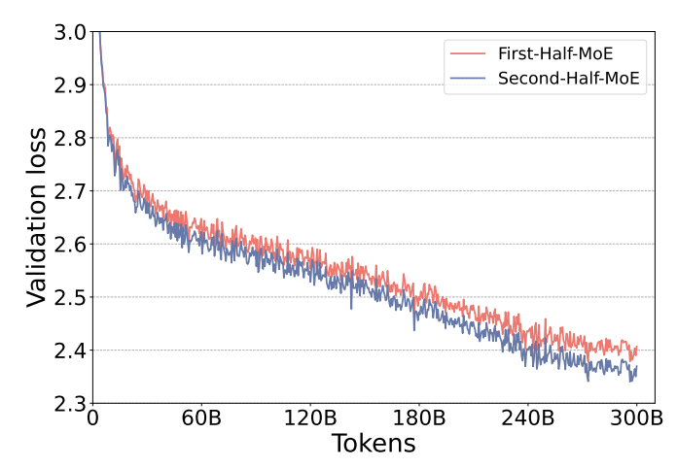
Key Insights Behind PR-MoE Design
Solution
PR-MoE (Pyramid-Residual MoE)
MoS (Mixture-of-Students)
PR-MoE architecture is based on two important observations:
Phenomenon I: Layer Specialization
Not all layers need the same number of experts
Deep layers (closer to output) benefit more from having multiple experts
Proven through experiment: Second-Half-MoE outperforms First-Half-MoE
Inspired by computer vision CNNs: deeper layers learn more specialized features
Validation loss of First-Half-MoE/Second-Half-MoE (top)
COMPUTER SCIENCE
GRAINGER ENGINEERING
Notes:
Evan
Their solution to parameter bloating was a combination of pyramid residual MoE and mixture-of-students (also known as MoS). First, let’s discuss PR-MoE - in the traditional MoE model architecture explained by Sanjay and Wendi earlier, all layers have the same number of experts. But with PR-MoE, it is built like a pyramid, with deeper layers having more experts that are routed to by the initial layers. This was inspired by the observation that computer vision convolutional neural networks had the deeper layers learn more specialized things. Their experiments found that the second half MoE performed better (had less validation loss) which we can observe in the figures on the left.

Slide 22
Key Insights Behind PR-MoE Design
Solution (Continued)
Phenomenon II: Efficient Expert Usage
Traditional solutions:
Add more experts (increases memory)
Use multiple experts per token (increases computation by 33%)
The PR-MoE Solution:
Uses fixed dense path + variable expert path
Acts like a residual network
Expert path serves as "error correction"
Achieves same quality as multiple experts
10% faster training due to reduced communication
COMPUTER SCIENCE
GRAINGER ENGINEERING
Notes:
Evan
The second phenomena we can observe is efficient usage of experts in the pyramid. Traditional MoE adds more experts and uses multiple experts per token, which puts strain on the total memory and computational requirement. Instead, in DeepSpeed, PR-MoE uses fixed path for dense parts and variable paths for experts, acting like a residual network that can “correct errors” and achieve the same quality as having multiple experts via routing. This results in 10% faster training from the reduced communication required.

Slide 23
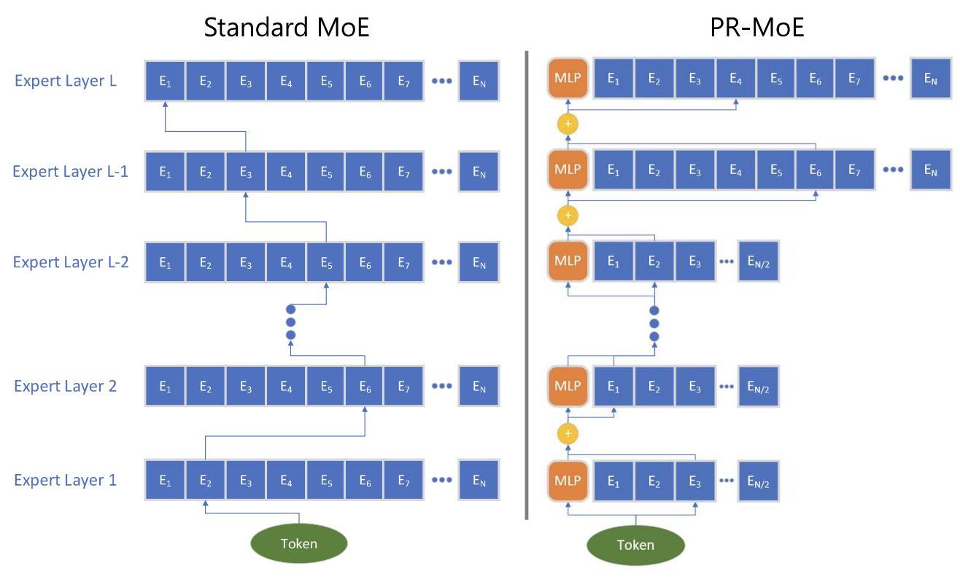
Putting Experts Where They Matter Most
Traditional MoE:
Same number of experts at all layers
Inefficient use of parameters
Uniform resource allocation
PR-MoE Pyramid Structure:
More experts in deeper layers
Example: 2x experts in final layers
Aligned with empirical findings
Resource allocation matches layer importance
Key Benefit: Better parameter utilization without sacrificing model quality
Figure showing illustration of standard MoE (left) and PR-MoE (right).
COMPUTER SCIENCE
GRAINGER ENGINEERING
Notes:
Evan
Let’s take a look at one of the paper’s figures that shows the PR-MoE architecture. On the left, we can see the standard MoE layers that have the same number of experts at all of them. But on the right, we are passing the token through layers of increasingly more experts per layer (almost like you are being redirected to the ideal expert). Ultimately, the key idea to takeaway here is that PR-MoE allows for better parameter utilization without sacrificing the model quality.

Slide 24
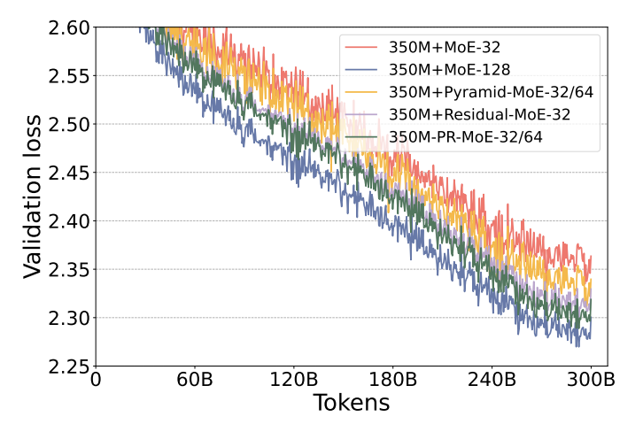
Evaluation of PR-MoE
Direct Comparison Testing
Evaluated w/ 350M and 1.3B parameters per token
Key Findings
Both Pyramid-MoE and Residual-MoE individually reduced the validation loss gap
Combined PR-MoE architecture further improved performance
Figure showing validation curves of different MoE models based on 350M+MoE.
COMPUTER SCIENCE
GRAINGER ENGINEERING
Notes:
Evan
But how does it perform? Well, the authors evaluated base models sizes of both 350M and 1.3B and found that the PR-MoE reduced the validation loss gap. Specifically, they found that when comparing the PR MoE to the traditional MoE with the same number of experts, PR-MoE reduces the validation loss gap. You may notice that PR-MoE with only 32 or 64 experts achieves the best loss except for the 350M-MoE 128, but the 128 has double the number of experts on every feed forward layer. Now that we understand a bit about PR-MoE, I’ll hand it over to Keshav to talk about the Mixture of Students, or MoS.
**Final dashed number (e.g., -128) is the total number of experts on every feed forward layer. From paper: “We use “350M+MoE-128” to denote a MoE model that uses 350M dense model as the base model and adds 128 experts on every other feedforward layer.”

Slide 25
Mixture-of-Students (MoS): The Next Step in Model Efficiency
Background Context: Traditional model compression typically uses:
Quantization
Pruning
Basic knowledge distillation
The MoS Innovation:
A novel approach to knowledge distillation that specifically targets MoE models while preserving their fundamental advantages. Unlike previous attempts that converted MoE to dense models, MoS maintains the sparse architecture that makes MoE powerful.
In other words, they found a solution that:
Preserves MoE's sparse architecture
Operates at billion-parameter scale
Maintains zero-shot task performance
COMPUTER SCIENCE
GRAINGER ENGINEERING
Notes:
Keshav

Slide 26


Mixture-of-Students (MoS): Explained like you are 5 years old
The Big Teacher:
Like a very smart professor
Knows lots of things
Takes lots of time and energy
Needs many computers to work
The Smart Students:
Smaller versions of the teacher
Learn directly from the teacher
Work faster because they're smaller
Almost as smart as the teacher
Work together as a team
Bottom line:
"Just like teaching assistants help a professor teach more students efficiently, MoS helps AI models work faster and use less resources while staying smart!"
COMPUTER SCIENCE
GRAINGER ENGINEERING
Notes:
Keshav

Slide 27
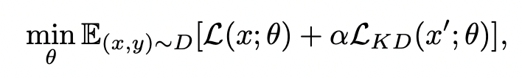
Staged Knowledge Distillation in MoS + PR-MoE
Key Innovation - Staged Knowledge Distillation
Discovery: Standard KD hurts accuracy in later training
Solution: Staged approach where KD is either:
Gradually reduced over time
Stopped early in training
Key Benefit: Preserve the inference advantages of MoE models and reduces computational requirements
Formulation of KD Loss
PR-MoS Combination:
Both teacher and student use PR-MoE architecture
Combines benefits of PR-MoE's efficiency
Maintains sparse architecture advantages
Further reduces model size while preserving quality
COMPUTER SCIENCE
GRAINGER ENGINEERING
Notes:
Keshav

Slide 28
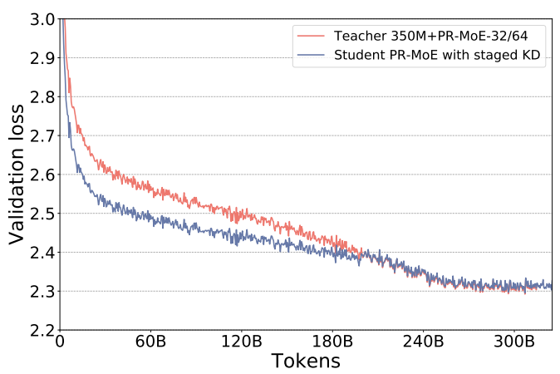
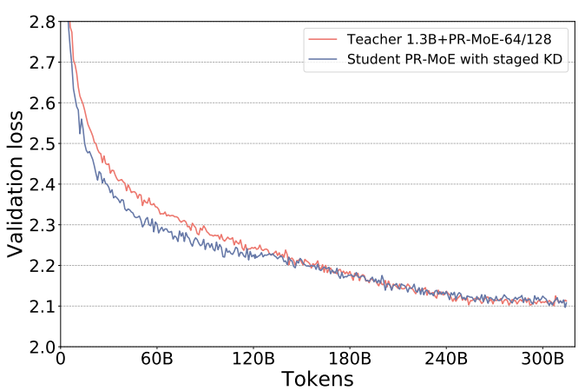
Evaluation of MoS
Key Evaluation Setup:
Tested on two model configurations:
350M+PR-MoE-32/64
1.3B+PR-MoE-64/128
Student models with 21 layers (12.5% of teacher depth)
Implemented staged knowledge distillation (KD stopped at 400K steps)
Key Results:
Validation Performance:
Staged KD achieved similar validation curves to teacher model
Significantly better than full-length KD
Figure showing The validation curves of training the student PR-MoE with staged knowledge distillation obtains almost the same validation loss as the teacher PR-MoE on both 350M+PR-MoE and 1.3B+PR-MoE.
COMPUTER SCIENCE
GRAINGER ENGINEERING
Notes:
Keshav

Slide 29
The MoE Inference Paradox
Best Case Scenario
Single token needs only one expert per layer
Example: 1.3B+MoE-128 model
Needs only 1.3B parameters per token
Despite total size of 52B parameters
How to optimize?
Worst Case Scenario
Different tokens need different experts
Full batch might require entire model (52B parameters)
Creates significant memory bandwidth pressure
COMPUTER SCIENCE
GRAINGER ENGINEERING
Notes:
Keshav

Slide 30
DeepSpeed-MoE's Solution
Three-Pronged Strategy
Smart Model Partitioning / Slicing
Multiple parallelism types
Efficient token grouping
Reduced data access per device
Results
Minimize critical data path per device
Maximize aggregate memory bandwidth
Enable massive model scaling
Achieve both low latency and high throughput
Optimized Communication
Coordinated parallelism
Efficient token routing
Minimized data movement
Enhanced Performance
Optimized transformer kernels
Improved MoE-specific operations
Maximum bandwidth utilization
COMPUTER SCIENCE
GRAINGER ENGINEERING
Notes:
Keshav

Slide 31
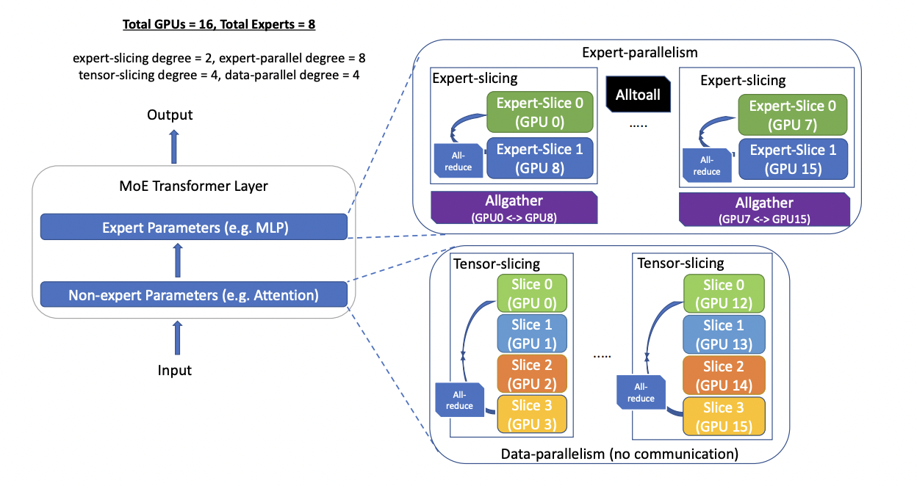
Model Partitioning and Slicing
Architecture
Expert Parallelism:
Partitions experts across devices
Groups similar tokens for efficiency
Real Impact: 1.3B+MoE-128 model
Only 1.3B parameters per device
vs 6.7B in equivalent dense model
Potential 5x speed improvement
Expert-Slicing:
Splits expert parameters horizontally/vertically
Enables scaling beyond expert count
Optimizes latency-sensitive scenarios
COMPUTER SCIENCE
GRAINGER ENGINEERING
Notes:
Keshav
Because this is a systems-focused course, an interesting part of their paper we can examine is the architectural makeup utilized to parallelize operations (both expert and non-expert).
By combining expert-parallelism and expertslicing with tensor-slicing and data-parallelism, DS-MoE inference can scale a multi-trillion parameter MoE model (with trillions of expert parameters and hundreds of billions of non-expert parameters) to dozens or even hundreds of devices across nodes.

Slide 32
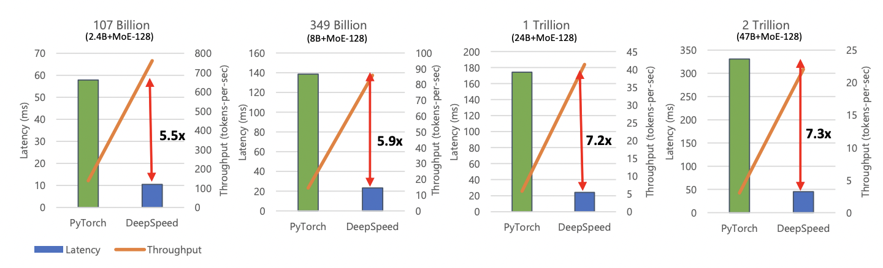
Revolutionizing MoE Model Inference
Inference Challenges:
Inference performance bottlenecked by memory bandwidth, not compute
Must efficiently manage parameter loading from main memory
Traditional small batch sizes compound the challenge
Solution exploits GPUs in parallel for inference at extremely low latency (< 25ms), even for huge models
COMPUTER SCIENCE
GRAINGER ENGINEERING
Notes:
Keshav

Slide 33
Switch Transformers: Scaling to Trillion Parameter Models with Simple and Efficient Sparsity
Fedus et al., 2022
COMPUTER SCIENCE
GRAINGER ENGINEERING
Notes:
We will now talk about Switch Transformers

Slide 34
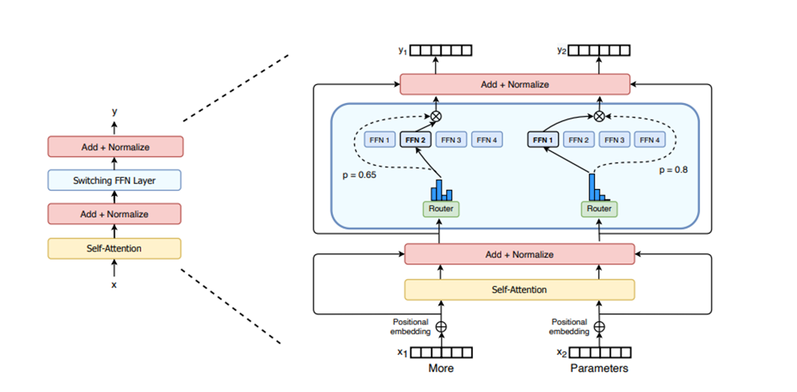
Switch Transformers
What’s New?
The Outrageously LNN MoE layer routes to more than 1 expert.
Switch Transformer instead uses a simplified strategy where routing to only a single expert (Switch Layer)
Benefits of Switch Layer
Reduced router computation
Expert capacity can be reduced
The routing implementation is simplified and communication costs are reduced.
COMPUTER SCIENCE
GRAINGER ENGINEERING
Notes:
Sanjay
In the Outrageously LNN paper, the authors intuited that learning to route would not work without the ability to compare at least two experts. Switch transformers proves that wrong by using a simplified strategy of routing to only a single expert

Slide 35
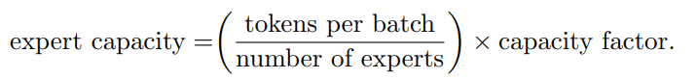
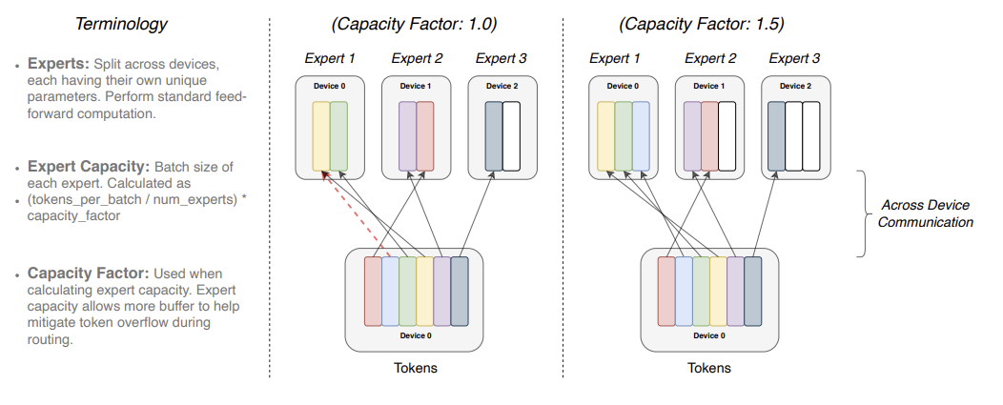
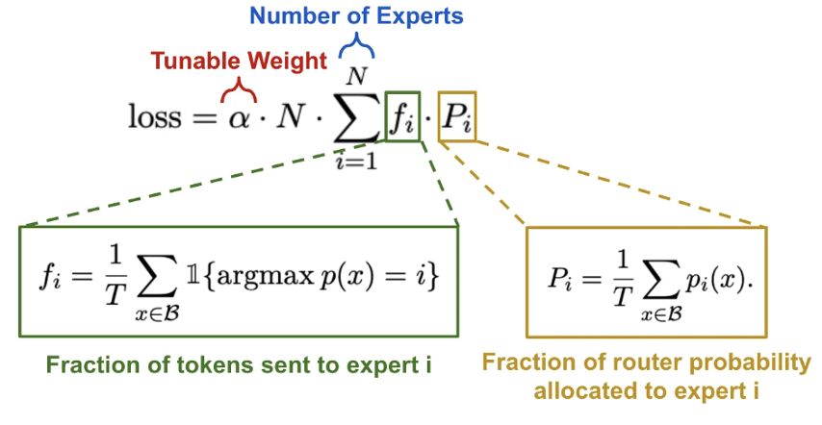
Efficient Sparse Routing
Distributed Switch Implementation
Dynamic computation due to the routing decisions
A capacity factor greater than 1.0 creates buffer when not perfectly balanced
If too many tokens are routed to an expert (dropped token), computation skipped
High expert capacity drawback: wasted computation and memory
Auxiliary Loss for Load Balancing
Recall: separate load-balancing and importance loss in Outrageously LNN paper
Simplified: a differentiable load balancing loss added to total model loss at each Switch Layer
COMPUTER SCIENCE
GRAINGER ENGINEERING
Notes:
In MoE’s our computation is dynamic due to the routing decisions at training and inference. As a result one important technical consideration is how to set the expert capacity. The expert capacity is the number of tokens a expert processes and is calculated by the formula show in in the top right of the slide.
A capacity factor greater than 1.0 creates buffer when not perfectly balanced.
If too many tokens are routed to an expert and the expert is not able to keep up, the computation for some tokens are skipped and is forwarded directly to the next connected layer
Now you might think, why don’t we just increase the capacity of each expert? Well we can but doing so will result in wasted computation and memory. So we don’t want to do it.
The diagram on the right is a visualization on how increasing the capacity factor >1.5 impacts the token distribution amongst experts. When the capacity factor is 1.0, the red dotted line denotes a token that was dropped. But when the capacity was increased, the expert was able to process it.
To encourage balanced load balancing across experts, the authors added an auxiliary loss, calculated by the equation under the diagram.
Given N experts and a batch B with T tokens, the auxiliary loss is computed as the scaled dot-product between vectors f and P
fi is the fraction of tokens dispatched to expert i
Pi is the fraction of the router probability allocated for expert i
α is a hyper-parameter
N is the expert count

Slide 36
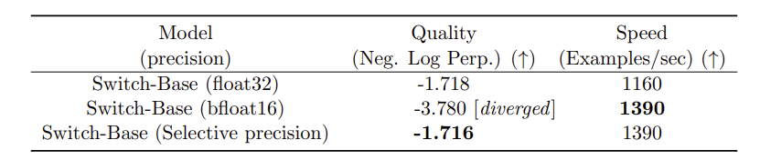
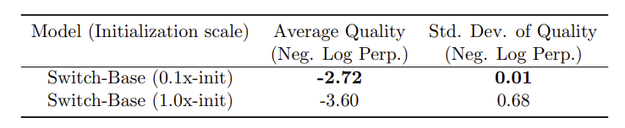
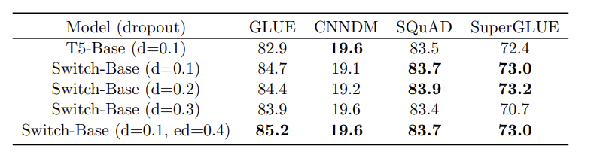
Improved Training and Fine Tuning
Selective Precision
Model instability hinders the ability to train using float16 precision
Selectively casting to float32 precision with a localized part of model (router input - float32; router output float16)
Stability achieved without expensive communication cost of passing float32 tensors around
Smaller Parameter Initialization
Initialize by drawing from a truncated normal distribution with mean µ = 0 and standard deviation σ =√(s/n)
Reduce the default Transformer initialization scale s=1.0 by a factor of 10
This resulted in improvement in quality and reduces likelihood of destabilization during training
Fine Tuning Regularization
Increase the dropout inside the experts
COMPUTER SCIENCE
GRAINGER ENGINEERING
Notes:
Sanjay
A known issue with Sparse expert models is that they may introduce training difficulties over a vanilla Transformer. Instability can result because of the hard-switching (routing) decisions at each of these layers. The authors discuss the following methods that they used to overcome these issues
Selective Precision:
Point 1 -> we overcome this model instability by -> Point 2
-> Because the resulting dispatch and combine tensors are recast to bfloat16 precision at the end of the function, no expensive float32 tensors are broadcast through all-to-all communication operations, but we still benefit from the increased stability of float32
Smaller Parameter Initalization:
Appropriate initialization of weights is critical to successful training in deep learning. We initialize our weight matrices by drawing elements from a truncatednormal distribution
-> s is a scale hyper parameter
-> n is the number of input units in the weight tensor
Fine Tuning Regularization:
-> The authors found that setting a smaller dropout rate (0.1) at non-expert layers and a much larger dropout rate (0.4) at expert layers led to better performance

Slide 37
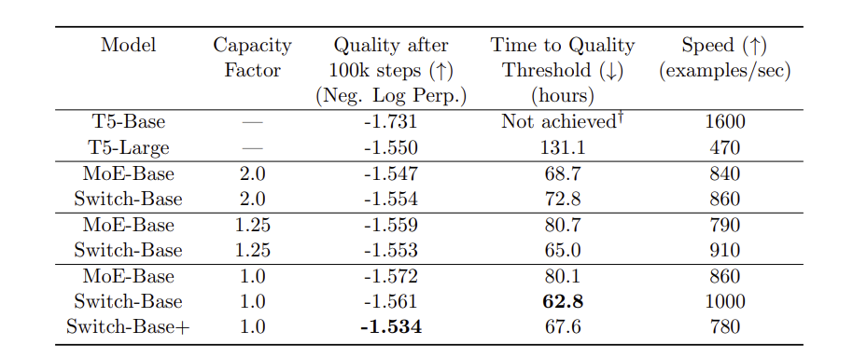
Pre-Training Performance
Given a Masked Modeling Task:
Pre-training on the “Colossal Clean Crawled Corpus” (C4)
FLOP-matched to T5-base
Switch Transformers outperform both T5 dense and MoE transformers on speed-quality basis
Smaller computational footprint than the MoE counterpart
Switch Transformer performs better at lower capacity factors (1.0, 1.25)
COMPUTER SCIENCE
GRAINGER ENGINEERING
Notes:
Wendi
To evaluate the Pre-Training Performance, they developed a FLOP-matched model (same amount of computation per token is applied), Switch-Based Model, to the T5-base model, which is Text-to-Text Transfer Transformer with around 200M parameters. Both are pretrained on the Colossal Clean Crawled Corpus (C4) on a masked modeling task.
They compare Switch_Based model to T5-base (200M), T5-large(700M), and MoE-Base Model (Top-2 experts), with the same amount of computation (32 cores) and on the same hardware (TPUv3).
The evaluation is done in three perspectives, (1) quality after 100k steps using the Neg Log Perplexity. The larger the better (2) Time to quality threshold (where they artibutraly choose -1.5 as the threshold) and (3) The speed.
They showed that the [Read slides]

Slide 38
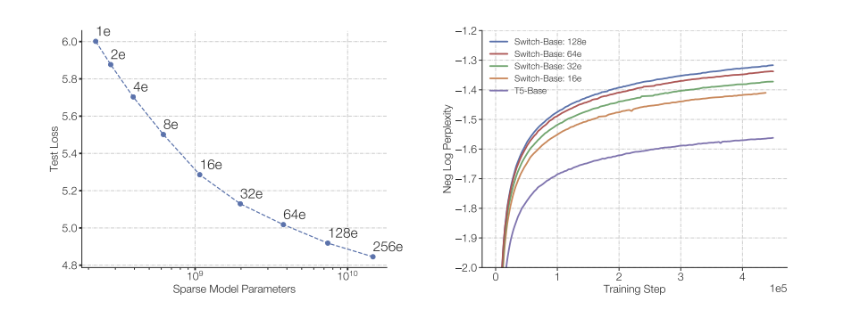
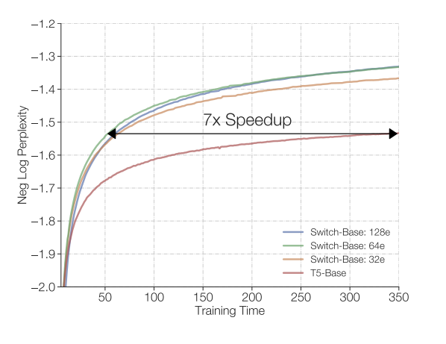
Scaling Properties
On a step basis, as number of experts increase, the performance consistently improves
For a fixed training duration and computational budget, Switch Transformers yield a substantial speed-up
Scaling properties
Speed advantage
COMPUTER SCIENCE
GRAINGER ENGINEERING
Notes:
Wendi
Considering a regime where the model is not bottlenecked by either the computational budget or amount of data, the scaling property is also evaluated. The most efficient dimension for scaling our model is by increasing the number of experts. Increasing the experts keeps the computational cost approximately fixed since the model only selects one expert per token, regardless of the number of experts to choose from.
Figure 1 left: measure the quality improvement as the parameters increase by scaling the number of experts. Moving from top-left to bottom-right, we double the number of experts from 2, 4, 8 and so on until the bottom-right point of a 256 expert model with 14.7B parameters. Despite all models using an equal computational budget, we observe consistent improvements scaling the number of experts.
Figure 1 right : Negative log perplexity per step sweeping over the number of experts. The dense baseline is shown with the purple line and we note improved sample efficiency of our Switch-Base models.
Figure 2t: Speed advantage of Switch Transformer. All models trained on 32 TPUv3 cores with equal FLOPs per example. For a fixed amount of computation and training time, Switch Transformers significantly outperform the dense Transformer baseline. The 64 expert Switch-Base model achieves the same quality in one-seventh the time of the T5-Base and continues to improve.

Slide 39
Scaling Vision-Language Models with Sparse Mixture of Experts
Shen et al., 2023
COMPUTER SCIENCE
GRAINGER ENGINEERING

Slide 40
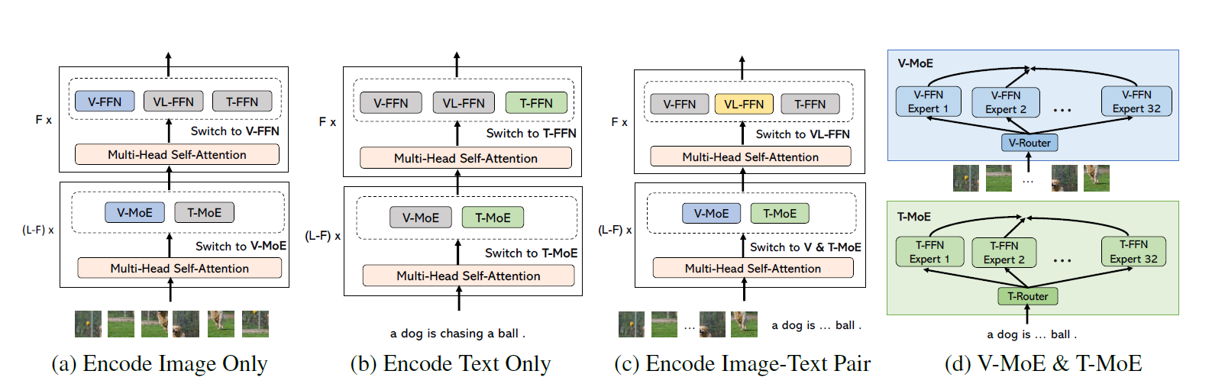
VL-MoE
Motivation
VKMs (Large-scale vision-language models) are becoming increasingly complex and computationally expensive
Solution: VL-MoE
VL-MoE
Uses MoE to scale both text-based and vision-based feed-forward networks
Divides model into specialized sub-models that handle different aspects of input processing
Employs three mask data modeling objectives for aligning text and vision representations
COMPUTER SCIENCE
GRAINGER ENGINEERING
Notes:
Charles
And finally, let me introduce VL-MoE. This architecture addresses the increasing complexity of vision-language models through three key innovations:
The model is divided into specialized experts for vision and text processing, shown here in these diagrams. The model flexibly routes inputs to either vision experts, text experts, or both depending on the task.
Most importantly, unlike traditional MoE approaches, this design prevents routing conflicts between vision and text inputs, leading to more stable training and better performance.
In testing, this approach achieved state-of-the-art results across major benchmarks while using significantly fewer parameters per token than comparable models.

Slide 41
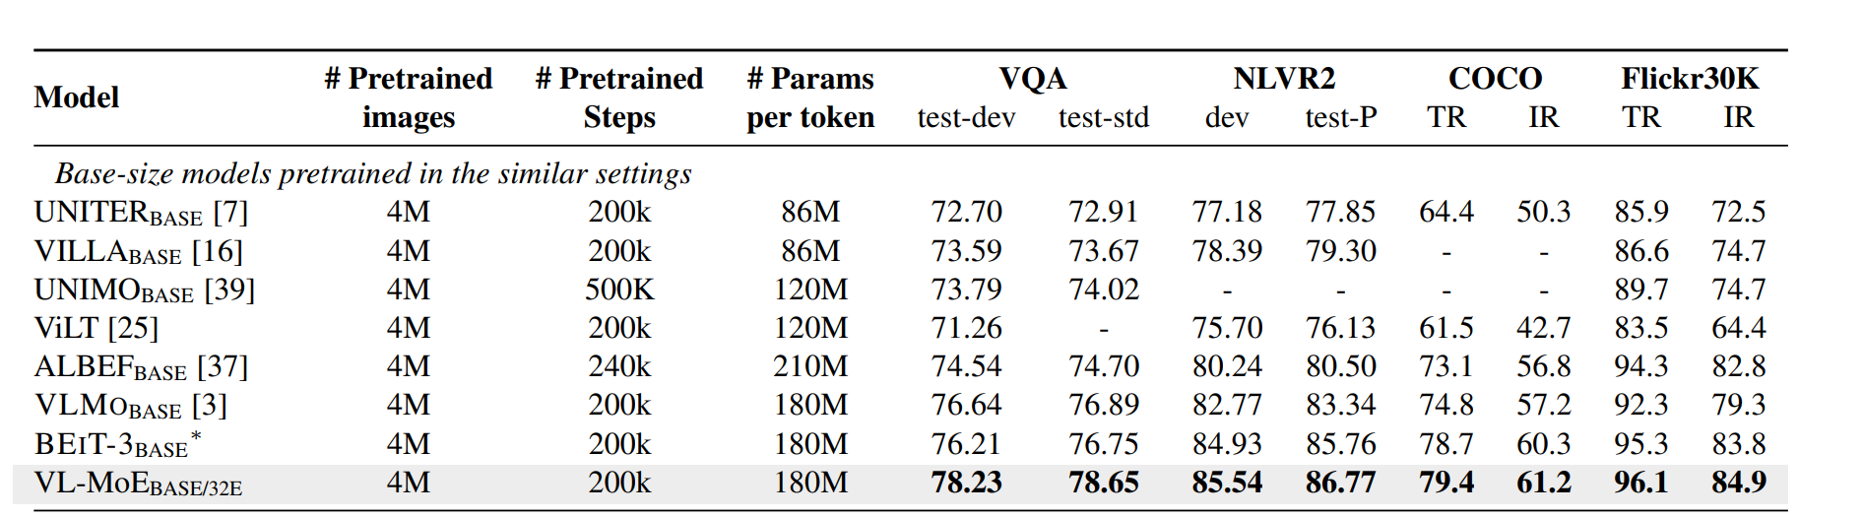
Pre-Training Performance
In comparison with models trained on similar amounts of data (4M images) and comparable training steps (200K), VL-MoE demonstrates superior performance across benchmarks
COMPUTER SCIENCE
GRAINGER ENGINEERING
Notes:
Charles
Let's look at the performance metrics. VL-MoE model matches competitors in training parameters and data - using 4 Million images and 200 Kilo steps - but achieves consistently better results across all benchmarks.
MoE-Base use top-2 experts
Table 1: Benchmarking Switch versus MoE. Head-to-head comparison measuring per step and per time benefits of the Switch Transformer over the MoE Transformer and T5 dense baselines. We measure quality by the negative log perplexity and the time to reach an arbitrary chosen quality threshold of Neg. Log Perp.=-1.50. All MoE and Switch Transformer models use 128 experts, with experts at every other feed-forward layer. For Switch-Base+, we increase the model size until it matches the speed of the MoE model by increasing the model hidden-size from 768 to 896 and the number of heads from 14 to 16. All models are trained with the same amount of computation (32 cores) and on the same hardware (TPUv3). Further note that all our models required pre-training beyond 100k steps to achieve our level threshold of -1.50. † T5-Base did not achieve this negative log perplexity in the 100k steps the models were trained

Slide 42
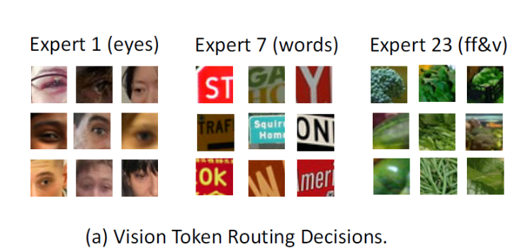
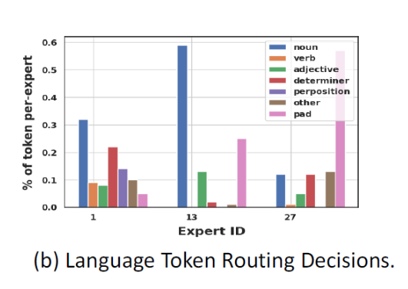
Expert specialization
Vision experts focus on specific features (eyes, text, objects)
Language experts handle different syntactic elements
Balanced routing prevents multi-modal imbalance issues
COMPUTER SCIENCE
GRAINGER ENGINEERING
Notes:
Charles
Looking at how the experts specialize, we see clear evidence of meaningful specialization. (Take Expert 1 for example - it's become dedicated to processing eye-related features. Expert 7 handles text and signage, while Expert 23 specializes in flora and vegetation.)
For language processing, the graph shows how different experts handle specific syntactic roles - (some focusing on nouns, others on adjectives or determiners).
This specialization, combined with our balanced routing approach, prevents the common problem of modal competition we see in traditional MoE architectures, leading to more stable training and better overall performance

Slide 43
Takeaways
TL;DR
COMPUTER SCIENCE
GRAINGER ENGINEERING
Notes:
Now that we’ve gone through MoE in detail, let’s discuss some overarching takeaways, a sort of TL;DR if you will.

Slide 44
Mixture-of-Experts Overview
Strengths
The Sparsely Gated MoE introduced an efficient implementation of MoE in language models but still present challenges related to memory constraints, limited application scope, and inference efficiency. (2017)
Weaknesses
Some challenges remain:
Cross-device communication overhead
Load-balancing across experts
"Expert collapse," if a small subset of experts dominate computation
Deployment and maintenance complexity
Optimize applications to NLP, scientific discovery, other domains
DeepSpeed introduces optimizations, such PR-MoE and MoS, to improve memory and inference efficiency for MoE models. (2022)
Switch Transformer actives only one expert per token, significantly reducing computation while preserving model quality. (2022)
VL-MoE innovates by separating experts for vision and text modalities to prevent instability from modality imbalance. (2023)
COMPUTER SCIENCE
GRAINGER ENGINEERING
Notes:
Evan
We’ve discussed the mixture-of-experts models in great detail. First, we went over the sparsely gated MoE powering outrageously large neural networks that introduced MoE despite challenges present for memory and inference efficiency. Then, we explained how Microsoft’s DeepSpeed paper introduced a variety of optimizations such as pyramid residual MoE and Mixture of Students (or MoS) to improve the training and inference efficiency. After that, we discussed the switch transformer that only activates one expert per token to reduce computational cost, and the application of MoE to vision language models to reduce modality imbalance.
Despite all these strengths of MoE, some challenges remain that can inspire future research. Cross device communication comes with some overhead cost, load balancing across the experts to avoid “collapse” when a small set of experts dominate computational runtime, the complexity of deploying and maintaining MoE models, and optimizing their applications across domains.

Slide 45
Further Research and Resources
Future Work
Optimizing the cross-device communication in MoE
Even larger models with more parameters, enabling more computation (perhaps, video generation)
Parallelizing across edge devices with low latency and resilience
Additional Resources
Here are a few recent works we found that are related to MoE usage and/or innovation:
HyperMoE: Towards Better Mixture of Experts via Transferring Among Experts (Zhao et al., 2024) https://arxiv.org/abs/2402.12656
MoE++: Accelerating Mixture-of-Experts Methods with Zero-Computation Experts (Jin et al., 2024) https://arxiv.org/abs/2410.07348
COMPUTER SCIENCE
GRAINGER ENGINEERING
Notes:
Evan
Finally, let’s briefly discuss some of the future work and additional resources if you are interested. Much of the future work could involve tackling challenges described in the previous slide - optimizing cross-device communication with training and deploying MoE is one example. We imagine that even larger models with more parameters can leverage MoE, enabling more computation for things that are extremely intensive like video generation models. Also, perhaps someone can research parallelizing across edge devices to run MoE with low latency and resilience.
We don’t have the time to discuss in detail, but we have provided the link to two more recent papers that find improvements to MoE architecture.
[If questions]
HyperMoE has specific “modules generated based on the information of unselected experts serve as supplementary information, which allows the knowledge of experts not selected to be used while maintaining selection sparsity” (abstract)
MoE++ proposes a “framework that integrates both Feed-Forward Network~(FFN) and zero-computation experts. Specifically, we introduce three types of zero-computation experts: the zero expert, copy expert, and constant expert, which correspond to discard, skip, and replace operations, respectively.” to reduce computational overhead.

Slide 46

Thank You!
We open the floor for questions, comments, and discussion.
COMPUTER SCIENCE
GRAINGER ENGINEERING
Notes:
Evan
Thank you for listening, we open the floor to questions from the class or Reviewer group.

